Slide 1
Hello Everyone!!

Slide 2


Slide 3
World Happiness Index
126th out of 143 Nations

Slide 4

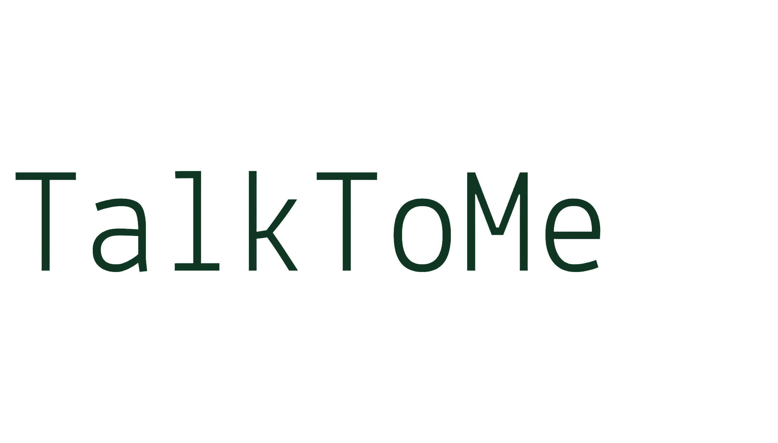

Slide 5
Introduction
“TalkToMe is a dedicated mental health chatbot created to support students in handling stress, anxiety, and emotional challenges during academic life.”

Slide 6
Salient Features
User Freindly
AI Supported
Understanding
Sentiment Analysis
NLP
Stress Managment
Clean & easily understandable UI
AI driven for better understanding
Clear understanding for relavent solution
Analyze the user’s messages and detect emotional states
Supports both text and voice
Manages Stress in a very efficient manner

Slide 7
Take care of your mental health
Self-care
Sleep Properly
1
Call friends
3
Stay active
2
4

Slide 8
BCA Elites Mohit Jangid Animesh Mathur Akshita Kumawat
Thank You

